Slide 1





SMART DOOR LOCKING SYSTEM
Universiti Teknologi MARA (UiTM) Shah Alam

Slide 2
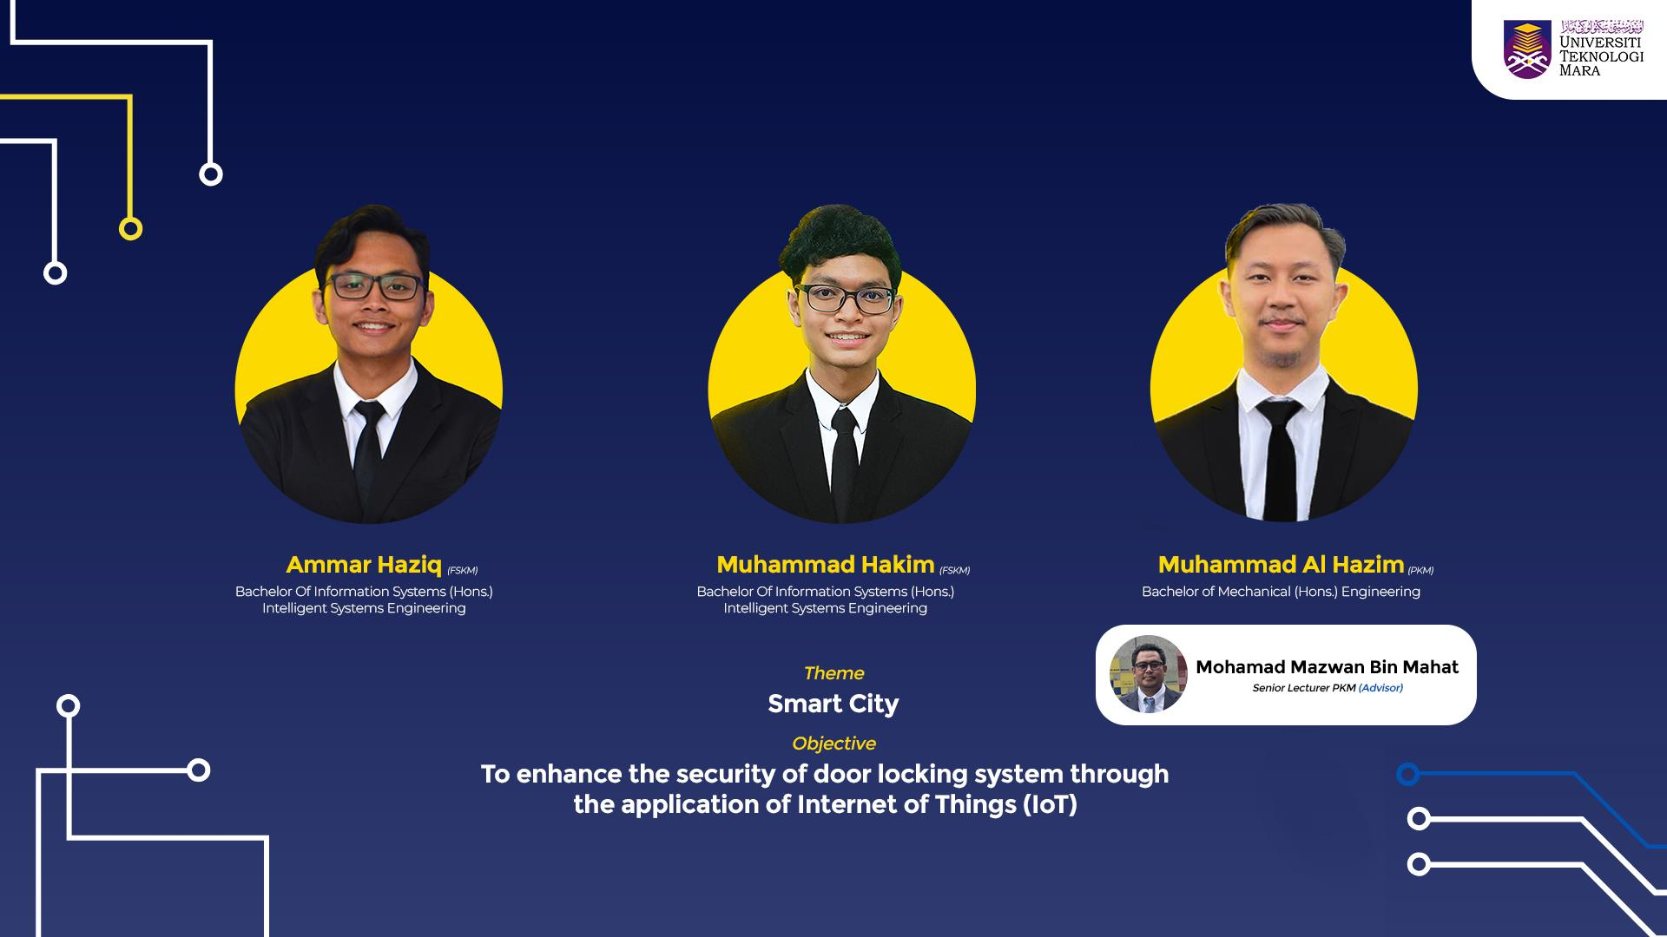
INTRODUCTION
Notes:
Project Intro
-Theme. (Smart city)
-Objective: To enhance the security of door locking system through the application of Internet of Things (IoT).
We have decided to use
-Aurdino and Raspberry pi

Slide 3
01
DEMO VIDEO DEMONSTRATION
(Raspberry Pi)
Notes:
DEMO VIDEO DEMONSTRATION (Backup up plan).
-Ammar explain the video.

Slide 4
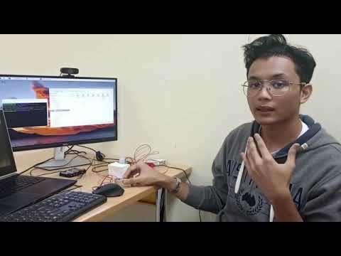
—AMMAR
Notes:
Demo Video Explanation

Slide 5
02
Cont.
Notes:
DEMO VIDEO DEMONSTRATION (Backup up plan).
-Hakim will share screen of Power bi, Mysql.

Slide 6
03
PROTOTYPE DEMONSTRATION (Arduino)
Notes:
Prototype Demonstration
-Hazim will open cam and show the Aurdino Project.

Slide 7
04
COMPARISON between
Raspberry Pi and Arduino
Notes:
Comparison
Raspberry Pi
-Supports the camera.
Arduino
-Requires the modification to get that function.

Slide 8
 | Arduino | Raspberry Pi
Cost | -Cheaper. | -More expensive.
Functionality | -No wireless connectivity. -Not compatible other external components. Ex: Camera & Microphone. | -Wifi Compatibility. -Compatible with a lot of external components.
Input | -Motion. -Distance. | -Face recognition. -Motion.
Output | -Servo motor. (open the door) | -Dashboard. -Solenoid (Door lock)
Notes:
Hardware restriction
(Face recognition - raspberry pi 2 gb)

Slide 9
THANK YOU
Notes:
Conclusion : we picked raspberry because it allows for face recognition for a smart door lock system. This is important because it contributes to IR 4.0 that caters to cloud computing.
Thank you

Slide 10
Q&A

